Slide 1
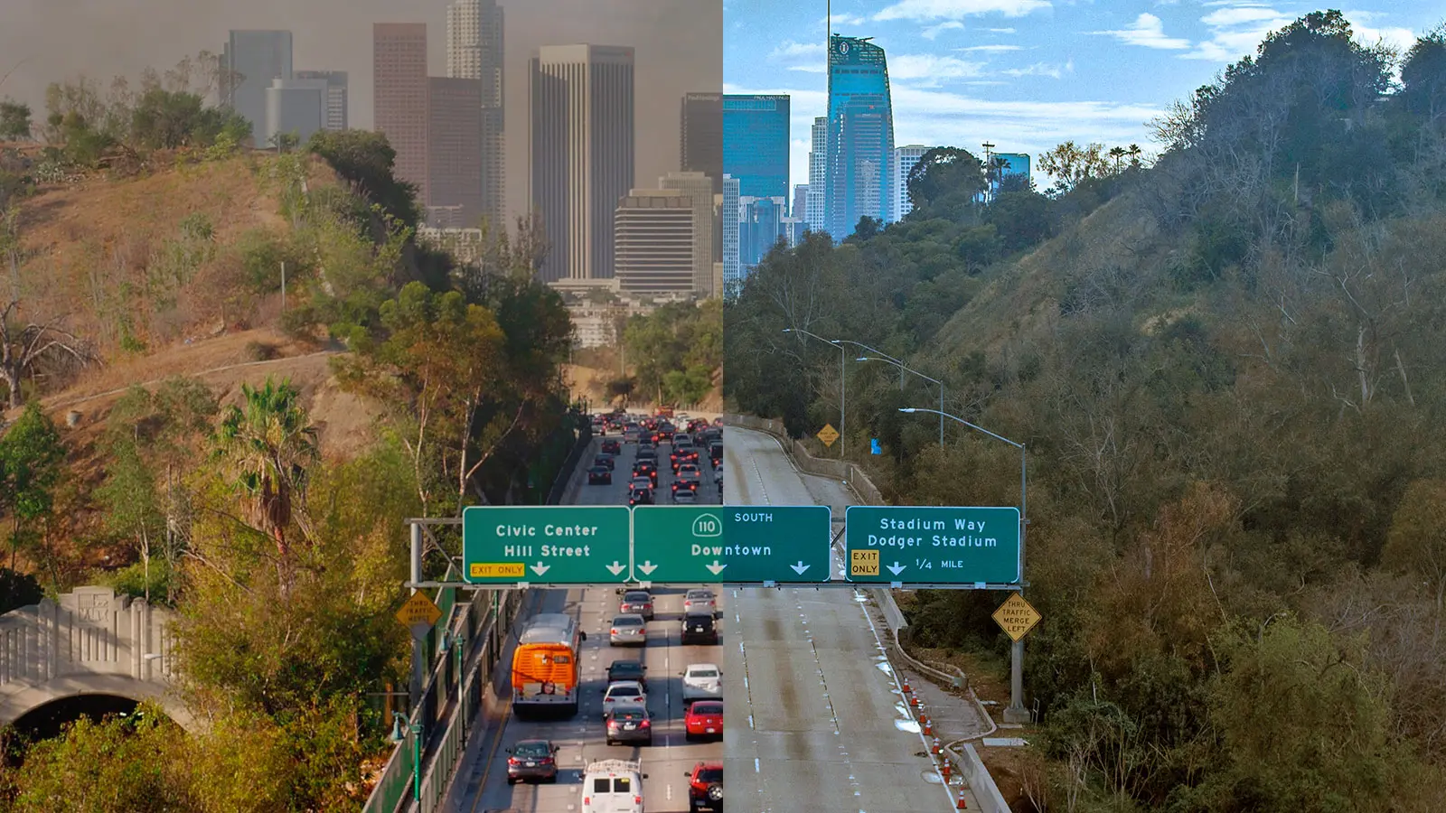


Rethinking
SB 375
Legislative pathways to transform California's transportation landscape
from incumbent stagnation
to climate accountability

Slide 2
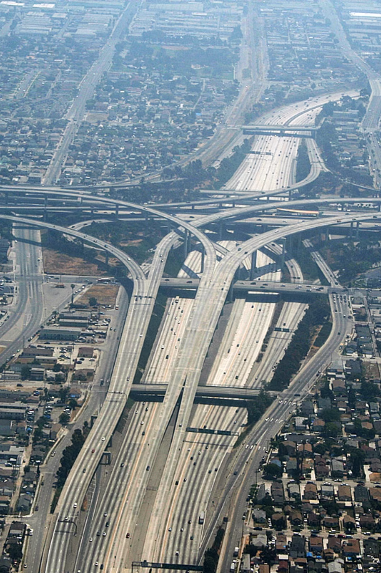
Californication:
A Traffic Problem
Californians drive nearly ~1 Billion miles DAILY.
~40,000 trips around the Earth's equator.
1
Notes:
I want to start not with policy — but with something everyone in this room has experienced. Sitting in traffic. Watching the air quality index tick up on a hot afternoon. Wondering why, despite everything we've heard about California's climate leadership, our roads keep getting more congested and our air keeps getting worse. That's what this project is about. And the answer isn't 'drive less.' It's about changing what we fund.

Slide 3
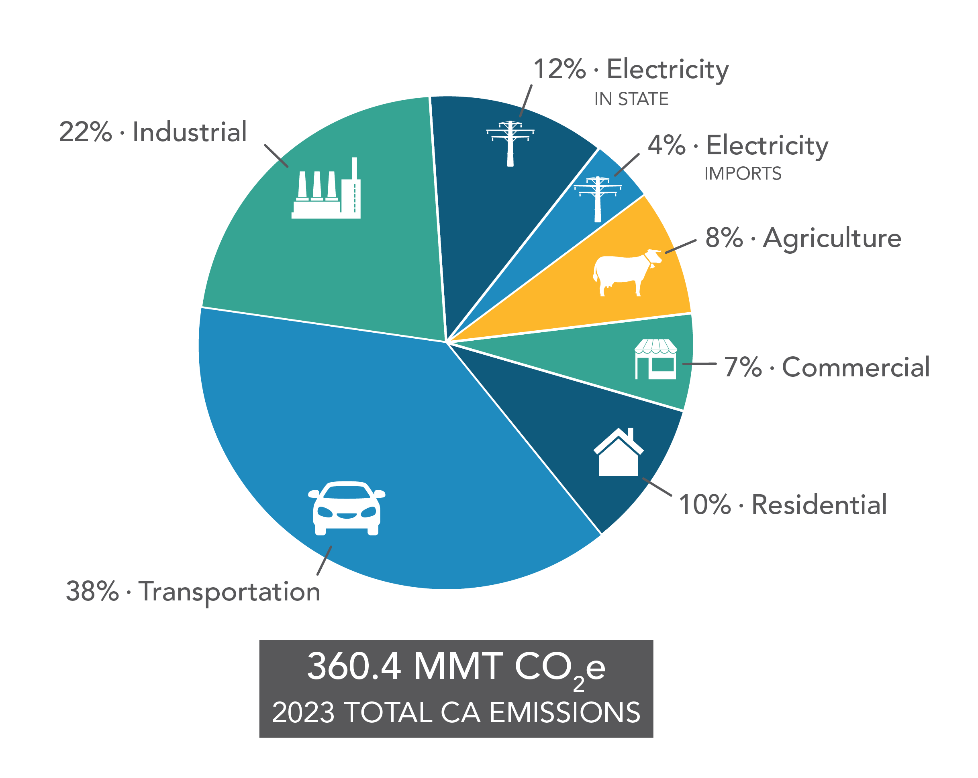
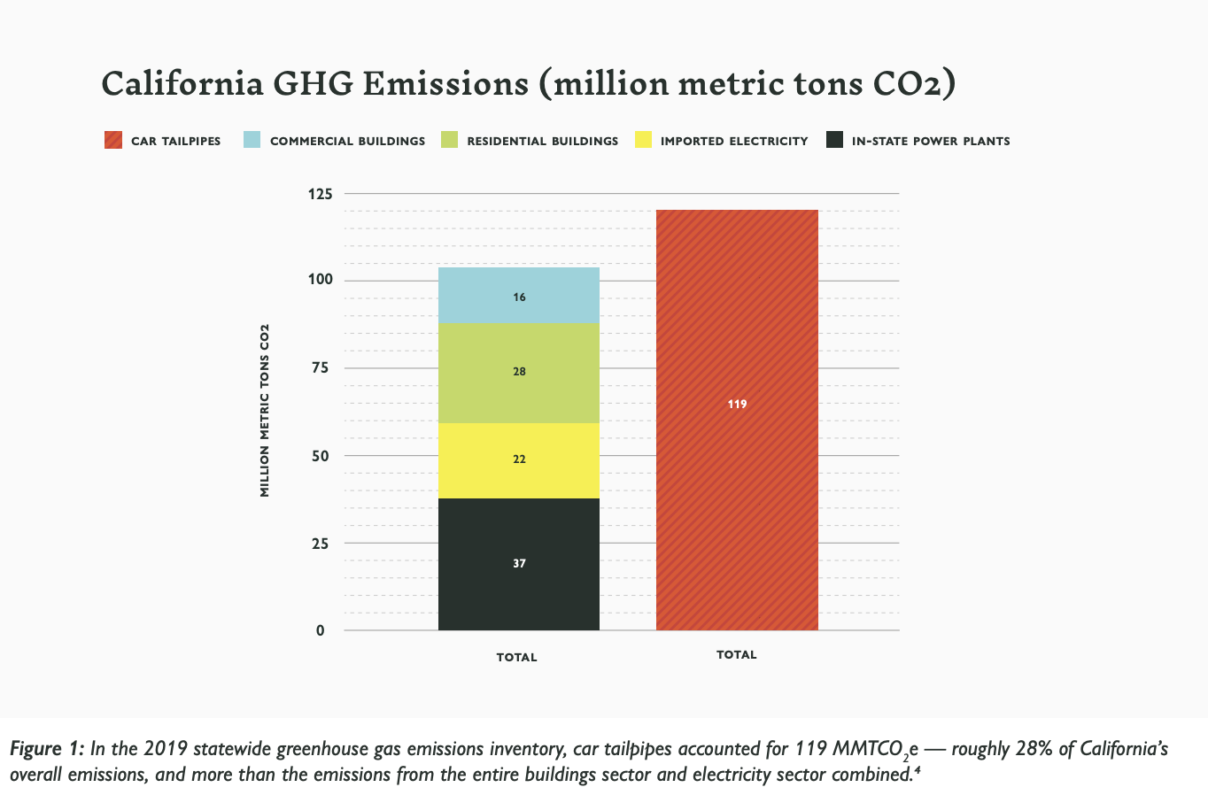
Transportation emissions largest source of CA share
38%
Statewide greenhouse gas emissions from transportation sector
~137 MMT
CO₂e emissions from transportation
Source: NextGen Policy
Source: CARB

Slide 4
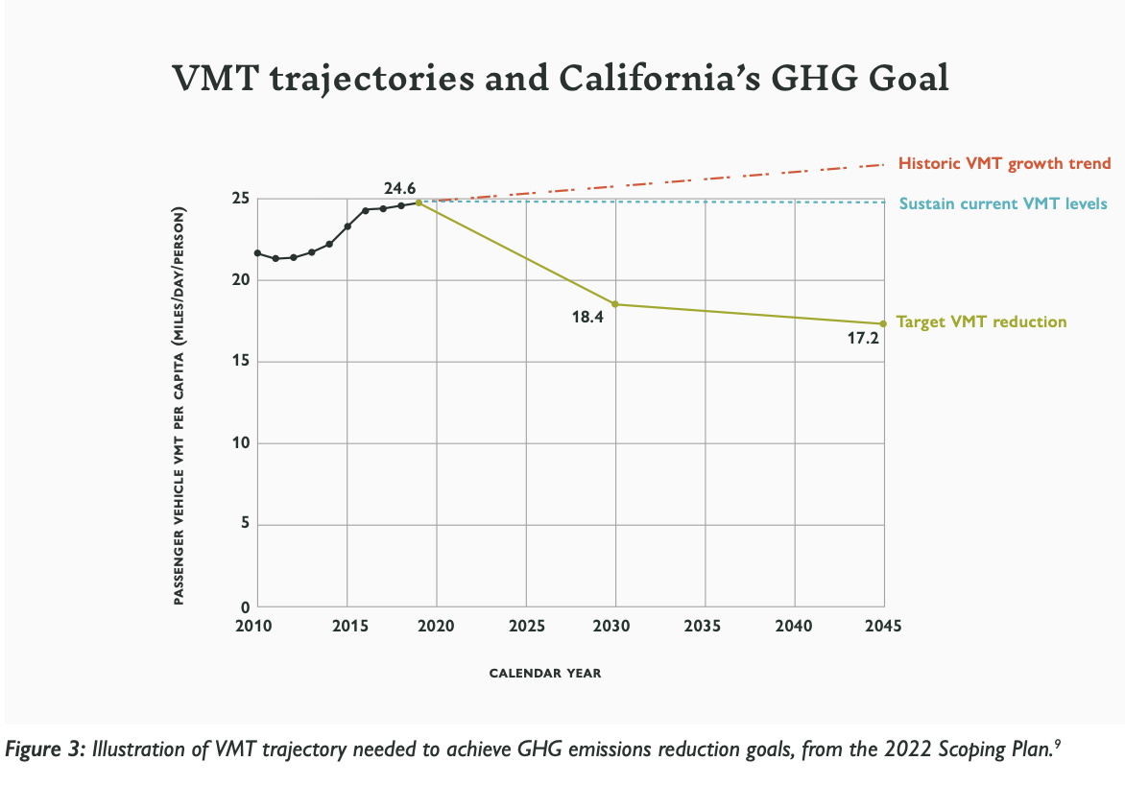
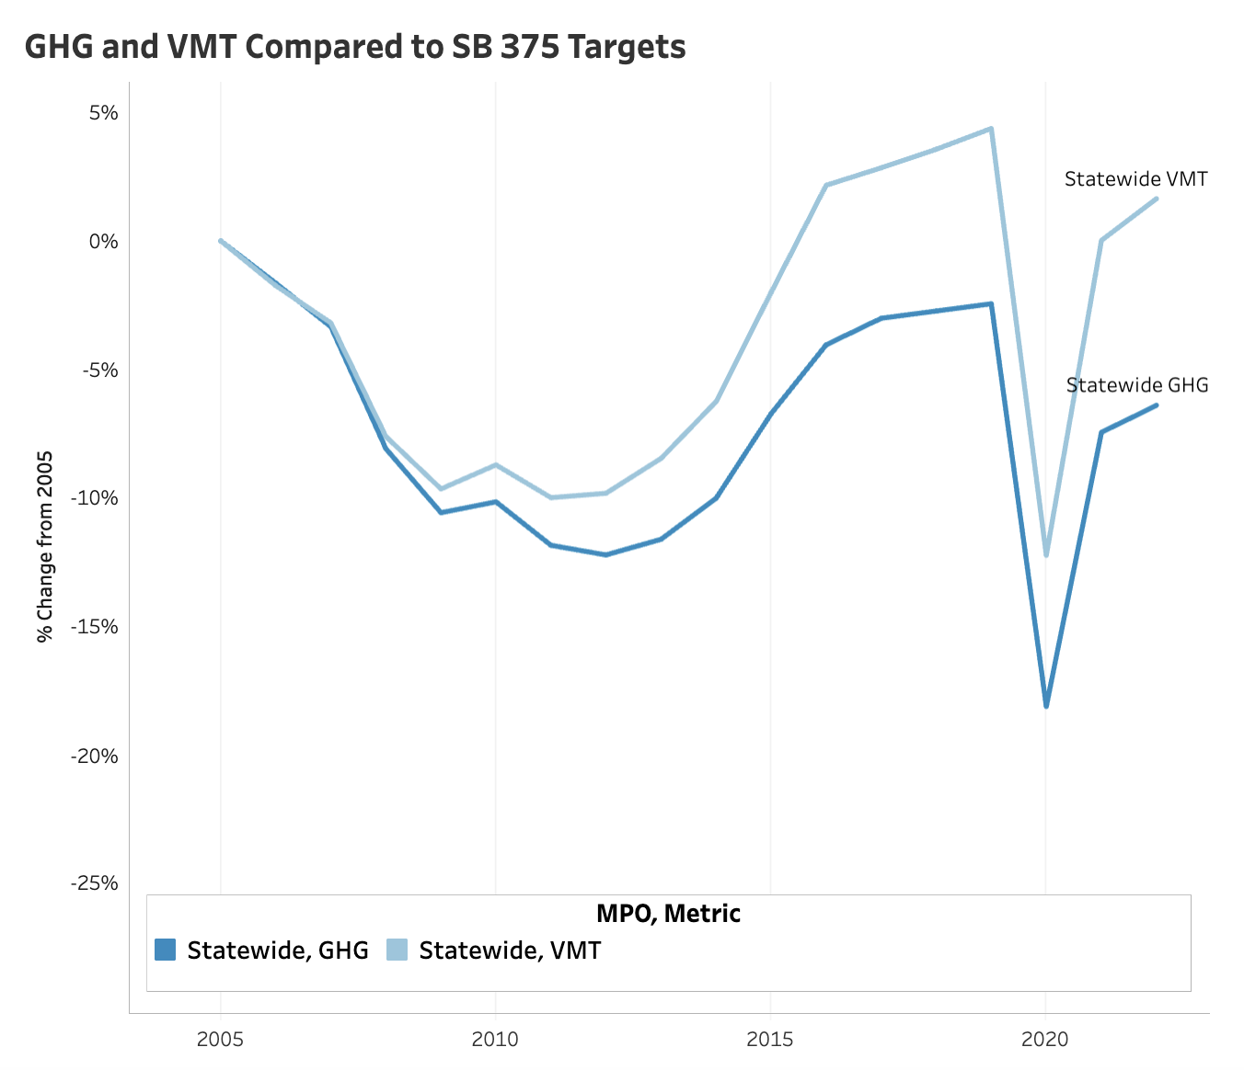
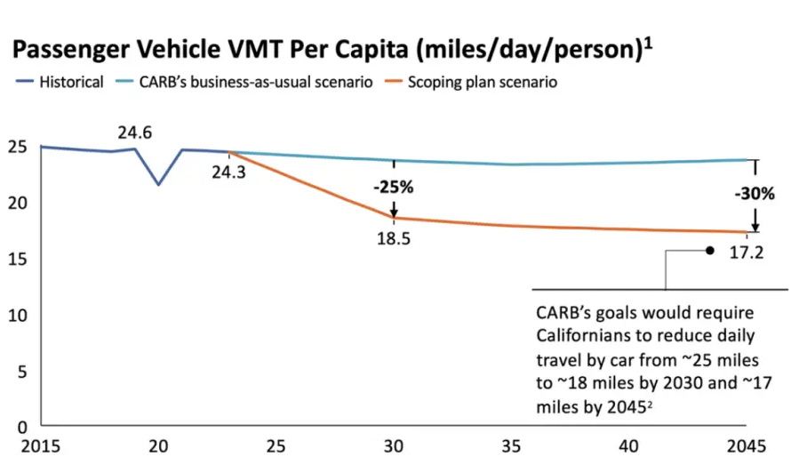
What Is VMT, and Why Does It Keep Going Up?
Vehicle Miles Traveled (VMT): the total miles driven by all cars in a region.
A measurement for California's climate transportation progress.
VMT: CA's daily driving tab
Californians drive about 24–25 miles per person per day
Carbon neutrality by 2045: ~17 miles per person per day
Gap is only growing
Source: NextGen Policy
3
Source: Streetsblog
Source: CARB
Notes:
VMT is the single most important metric in this presentation, so I want to make sure it's crystal clear. It's not complicated — it's just the total mileage bill California runs up every day. The reason it matters for climate is simple: more miles driven equals more fuel burned equals more emissions. What's striking is that even as electric vehicles have grown, total VMT has continued to climb — which means electrification alone won't get us there. We have to actually drive less, collectively.

Slide 5

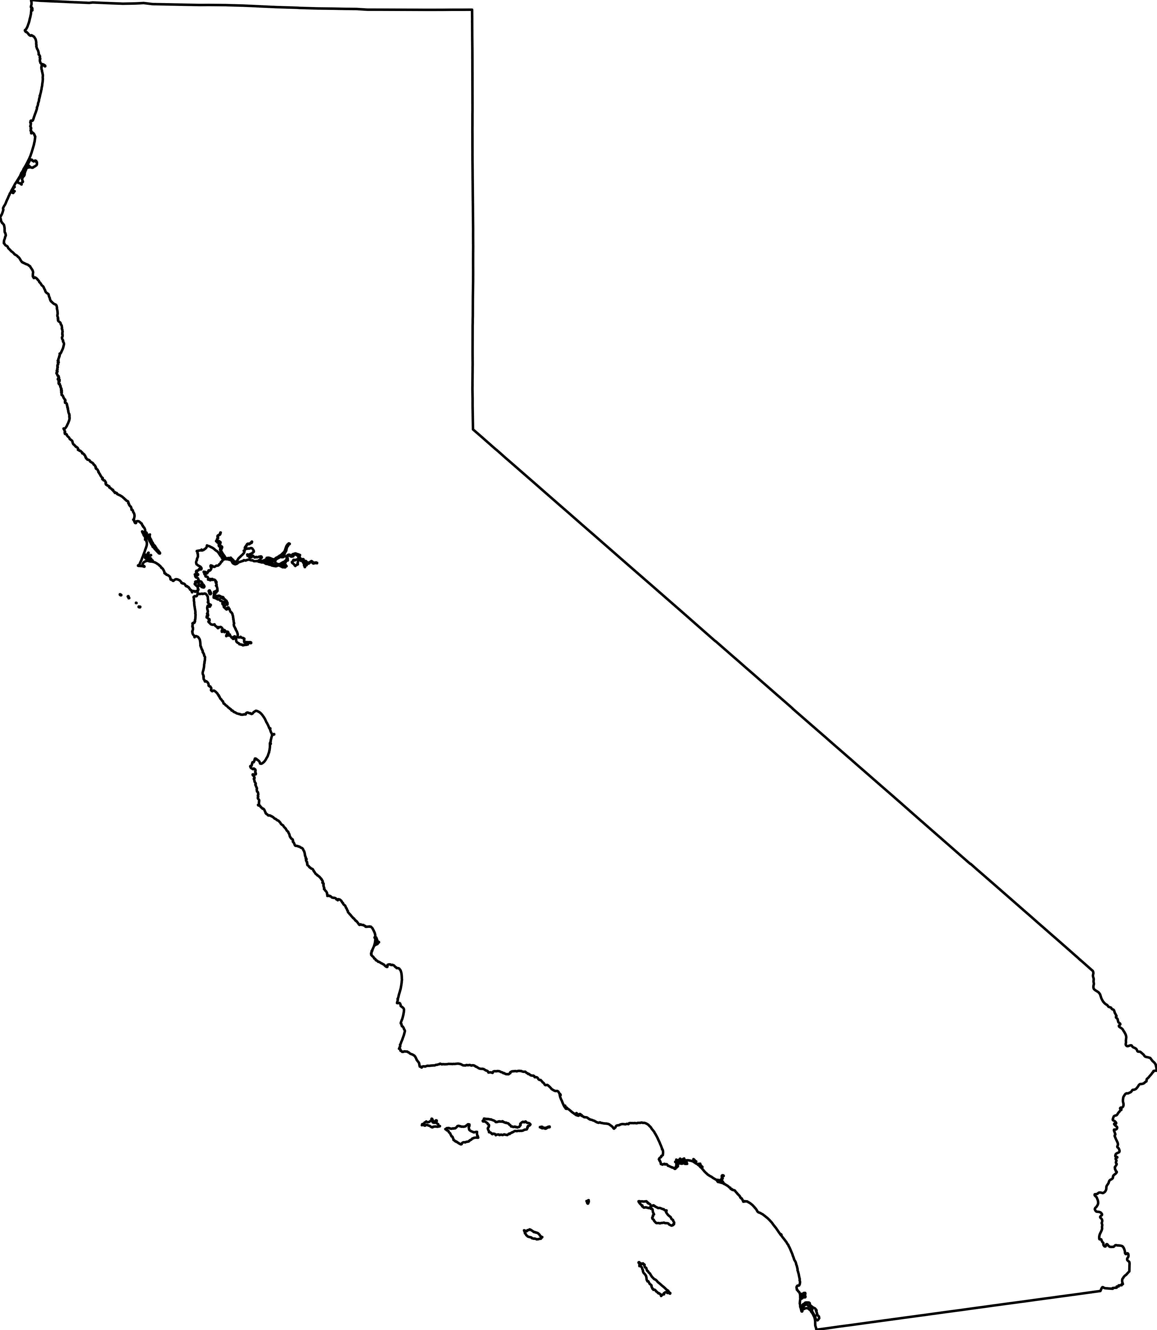
SB 375 (2008): Policy Meant to Address VMT and GHG
SB 375 (Steinberg, 2008) requires every CA region to create a plan showing how it will plan to reduce transportation emissions.
SB 375 requires California's 18 MPOs to each produce a Sustainable Communities Strategy (SCS): a transportation and land use plan aligned with state climate targets
Regions must show, on paper, how their plan achieves those targets
SB 375 was groundbreaking in 2008. Sixteen years later, VMT and GHG emissions are still rising
Update to the SB 375 Greenhouse Gas Emission Reduction Targets (CARB, 2018)
4
Notes:
SB 375 was genuinely a landmark law when it passed. It was the first in the country to link transportation planning to climate targets at a regional level. The idea was: if we require regions to plan for lower emissions, the spending will follow. Spoiler: it didn't. And the reason why is what I want to show you next.

Slide 6
Main Problem: Good Plans, No Enforcement
SB 375 requires regions to write plans that show a path to lower emissions.
It doesn't require them to follow the plan.
What SB 375 Requires
What SB 375 Doesn't Require
• Plans
• Projections
• Targets
• Spending alignment
• Enforcement
• Missed targets consequences
5
Notes:
This is the core insight of the whole project, and I want to make sure it lands. SB 375 is a planning mandate. It requires good documents. It does not require good spending decisions. And in practice, what we've seen is that regions produce plans showing impressive VMT reductions — and then fund projects that do the opposite. There's no mechanism that says: if you miss your target, you lose your highway funding. That's the gap we're trying to close. • Think of it like a gym membership where you write a detailed workout schedule every four years — but no one ever checks if you showed up
• Regions can submit a plan projecting significant VMT reductions, then fund highway expansions that generate more driving — with no legal consequence
• This gap between planning and spending is where climate progress gets lost
• Result: VMT and emissions are trending upward statewide, even as regions report "on track" in their plans

Slide 7

MCS Capstone Project Scope
Research was conducted in partnership with NRDC to find legislative pathways to make California's transportation spending match its climate goals.
Sponsor
The Question
The Approach
NRDC (Natural Resources Defense Council) is one of nation's leading environmental policy advocacy organizations.
Zak Accuardi, Director of Director, Mobility Choices, Climate & Energy.
California SB 375 requires regions to plan for lower GHG emissions.
But planning and implementation are two different things. Why isn't there better implementation?
Policy analysis + stakeholder interviews + spatial data mapping across 18 California Metropolitan Planning Organization (MPO) regions.
?
2
Notes:
This capstone was done through UC Berkeley's Rausser College of Natural Resources. My partner on the project was NRDC — the Natural Resources Defense Council — specifically Zak Accuardi, who works on exactly these questions professionally. I want to be upfront: this is a policy analysis project, not an engineering one. We're looking at how laws are written and how money flows — not at individual driver behavior.

Slide 8

Opportunity to Fix Issue: SB 1087 (Cabaldon)
A technical bill introduced in February 2026 amends same legal code as SB 375.
A rare window to insert real accountability.
What SB 1087 Does
Why This Matters
Introduced by Senator Cabaldon: makes administrative updates to CA's transportation planning framework:
Changes how often regions must update their plans (from every 4 years to every 8 years)
Changes how $25 million in planning grants are allocated (from discretionary to population-based)
Shifts grant administration away from Caltrans
SB 1087 can create legislative hooks to utilize specific code sections where climate accountability language can be inserted during the amendment process.
Can become a potential climate accountability bill.
6
Notes:
This is where the project gets strategic. We couldn't just amend SB 375 directly — the legal structure is too narrow for investment mandates. But SB 1087, introduced just this February, opens the right doors. It's currently a fairly dry administrative bill. But because it touches the same code sections, it gives advocates a vehicle to attach real enforcement mechanisms this legislative session. The window is open right now.

Slide 9
Other States Already Closed This Gap
Colorado, Minnesota, Virginia, and Massachusetts each passed laws that tie transportation dollars directly to climate performance. California can adapt all four.
COLORADO — Budget Lock
MINNESOTA — Capacity Trigger
Any project that increases emissions must be paired with transit, bike lanes, or demand management to offset the impact. No mitigation = no funding.
Any highway expansion over 0.5 miles requires a 20-year emissions impact study. If it fails, the project must be redesigned, offset, or canceled.
VIRGINIA — Climate & Equity Scoring
MASSACHUSETTS — Emission Caps
Projects are scored on GHG reduction, multimodal access, and benefits to disadvantaged communities. Sprawl-inducing projects naturally score lower and lose funding.
Legally binding, annually declining CO₂ limits for the state DOT. Miss the target and supplemental corrective measures are legally required.
7
Notes:
None of these states reinvented the wheel. They just added consequences. Colorado locked the budget. Minnesota required honest accounting. Virginia built equity into the scoring. Massachusetts made the targets legally binding. California has the policy infrastructure to do all four — we just need the political will to attach them to the right bill.

Slide 10
Reform Option 1: Corrective Action Moratorium
Modeled on: Colorado's GHG Budget Lock
Political viability: MODERATE: most feasible near-term option; consequence is VMT pause, not permanent cut
Corrective Action Status
Explicit Prohibition
Restoration Trigger
During Corrective Action Status, no state or federal funds shall be programmed, allocated, or expended for any project that adds a new through lane to the state highway system or a local arterial.
Prohibition remains in effect until CARB certifies the MPO's Corrective Action Plan includes sufficient, binding commitments to restore the region's path to its 2035 and 2045 GHG targets.
If a region fails to meet its GHG targets for two consecutive cycles, it shall enter Corrective Action Status.
Relationship to California: Adds enforcement power to the 8-year cycle by explicitly prohibiting capacity-increasing projects when regions miss targets, turning planning requirements into funding guardrails.
8
Notes:
This is the scenario I'd recommend as the starting point for this legislative session. It's not the most transformative option, but it's the most politically viable. The key insight is that it doesn't permanently cut anyone's funding — it creates a pause with a clear path to restoration. That makes it much harder to oppose. A region that's genuinely making progress has nothing to fear from this.
• Modeled on: Colorado's GHG Budget Lock
• Trigger: Two consecutive planning cycles with missed GHG (greenhouse gas) targets
• Consequence: No state or federal funds may be spent on projects that add new highway lanes until CARB (California Air Resources Board) certifies a credible Corrective Action Plan
• Restoration: Funding resumes only when the region demonstrates a binding path back to its 2035 and 2045 targets
• Political viability: MODERATE: most feasible near-term option; consequence is a VMT pause, not a permanent cut

Slide 11




Reform Option 2: VMT-Neutral Investment Rule
Modeled on: Minnesota's Capacity Trigger
Political viability: STRONG, but contested: highway agencies push back
GHG Impact Assessment
Any project adding vehicle capacity must complete a 20-year GHG and VMT impact assessment before inclusion in regional funding program.
VMT Mitigation Plan
If assessment shows net-increase in driving, project sponsor must fund VMT Mitigation Plan (transit improvements, bike infrastructure, or infill housing) that fully offsets projected 20-year impact
Mitigation Bank Integration
For any MPO in "Corrective Action Status," mitigation obligations must be fulfilled through the Statewide VMT Mitigation Bank (AB 130) or a regional VMT exchange program certified by the Office of Land Use and Climate Innovation.
Relationship to California: Requiring highway projects to fund their own alternatives through the VMT Mitigation Bank, forcing highway projects to pay for transit, biking, and infill housing.
9
Notes:
This one has real teeth. It basically says: 'Big Highway' projects have to fund their own climate offsets. If Caltrans wants to add a lane on I-5, it has to show that the induced demand won't blow up regional emissions targets — and if it will, it has to fund transit or housing alternatives that absorb that demand. This is how you stop the cycle of building more roads and then wondering why there's more traffic.
Modeled on: Minnesota's Capacity Trigger
• Requirement: Any project adding vehicle capacity must complete a 20-year GHG and VMT impact assessment before inclusion in regional funding program.
• If assessment shows net-increase in driving, the project sponsor must fund a VMT Mitigation Plan (transit improvements, bike infrastructure, or infill housing) that fully offsets projected 20-year impact.
• Political viability: STRONG, but contested: highway agencies will push back

Slide 12
Reform Option 3: Climate Floor Scoring Test
Modeled on: Virginia's SMART SCALE Scoring + Massachusetts' Enforceable Emission Caps
Political viability: TRANSFORMATIVE
Objective Need Standard
Climate Floor
Multimodal Alternatives Test
No project seeking state funding shall be eligible for programmed funds if it receives a negative net-score for VMT reduction, regardless of its performance in other scoring categories.
The California Transportation Commission, in consultation with CARB, shall establish Statewide Accessibility and Safety Targets. A project shall only be eligible for scoring if it addresses an objective need identified in the Statewide Needs Assessment, rather than a locally defined throughput metric.
Any project identifying mobility need: Scoring process must evaluate at least two Multimodal Alternatives with same analytical rigor as the proposed capacity project. If multimodal alternative achieves objective with higher net-climate score, capacity project (i.e., highway expansion) is statutorily ineligible for state funding.
Relationship to California: Transforms planning administrative update into a funding gatekeeper. Ensures Local Planning Grants are only used to study projects that can actually pass this Climate Floor test.
10
Notes:
This is the long game. It fundamentally restructures how California decides what gets funded — not by tweaking the scoring at the margins, but by establishing a hard floor. If your project makes climate worse, it doesn't get state money. Full stop. Virginia and Massachusetts have shown this is legally defensible and politically survivable — but it will require building a broader coalition than Scenario 1 to get there.
• Modeled on: Virginia's SMART SCALE Scoring + Massachusetts' Enforceable Emission Caps
• Climate Floor: Any project with a negative net score for VMT (Vehicle Miles Traveled) reduction is automatically ineligible for state funding, regardless of how it scores on other criteria
• Objective Need Standard: Projects must address a need identified in a statewide assessment — not just a locally-defined traffic throughput goal
• Multimodal Alternatives Test: For every mobility need identified, at least two non-highway alternatives must be evaluated with the same rigor as the capacity project
• If a multimodal option scores better on climate, the highway expansion is statutorily ineligible
• Political viability: TRANSFORMATIVE but faces strongest opposition

Slide 13
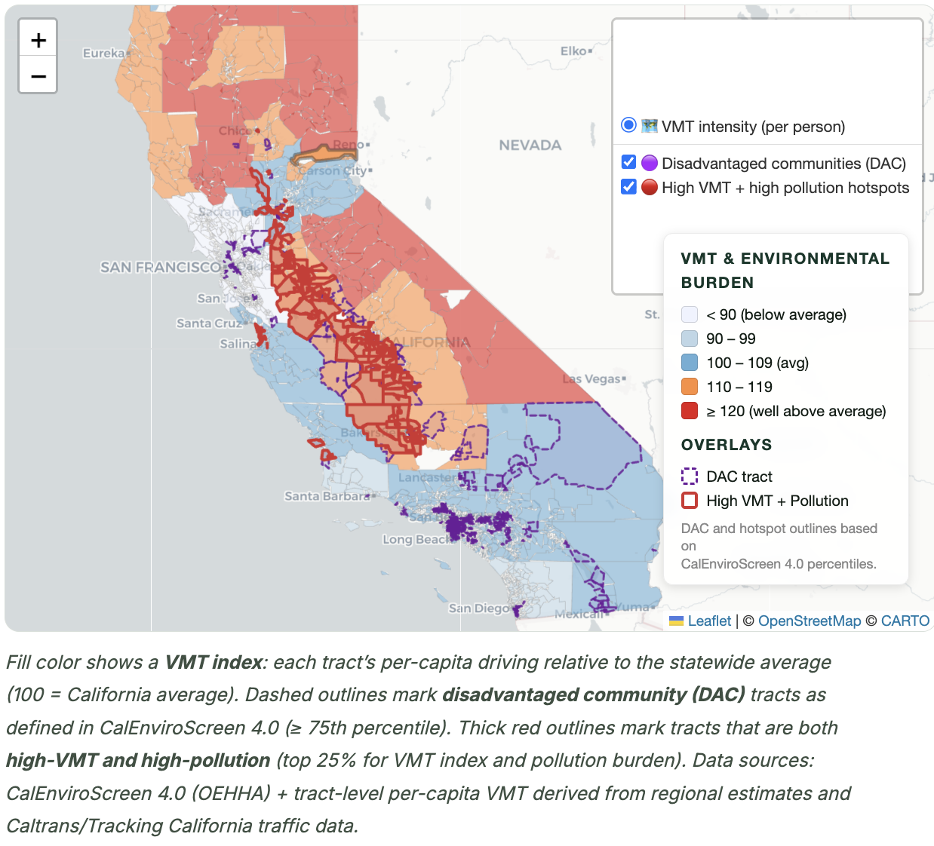
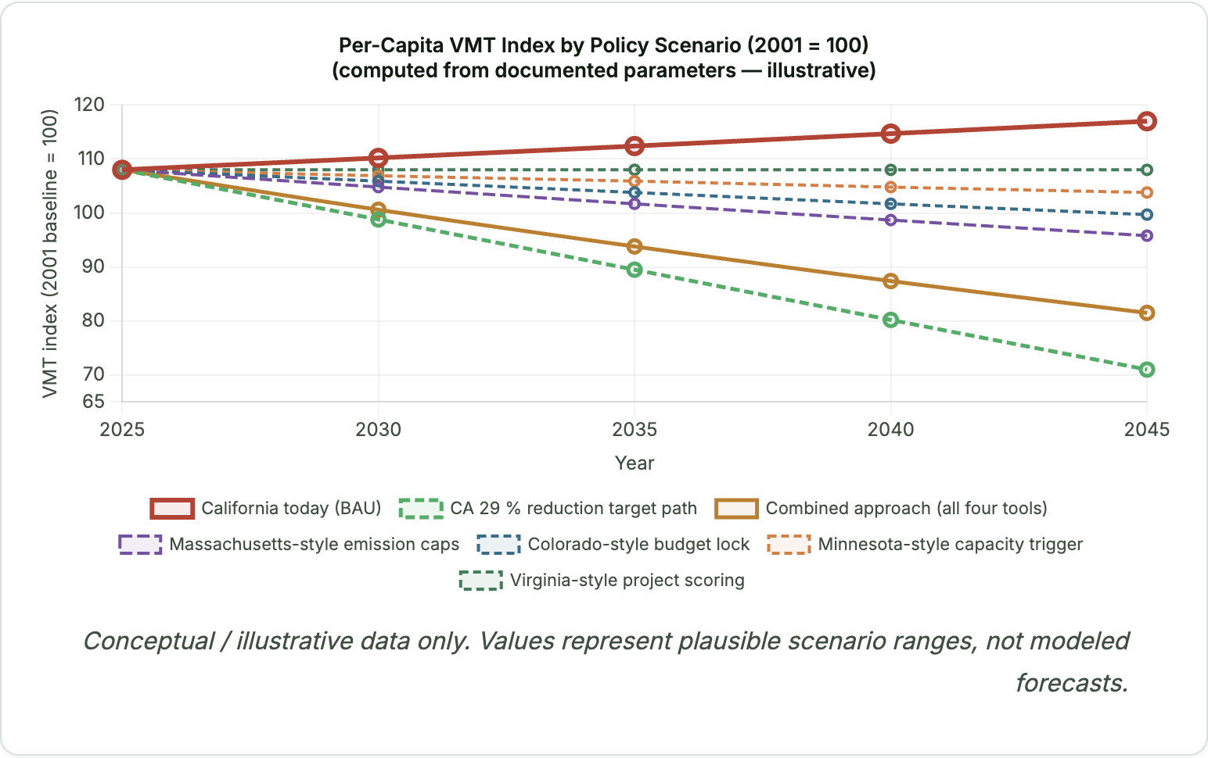
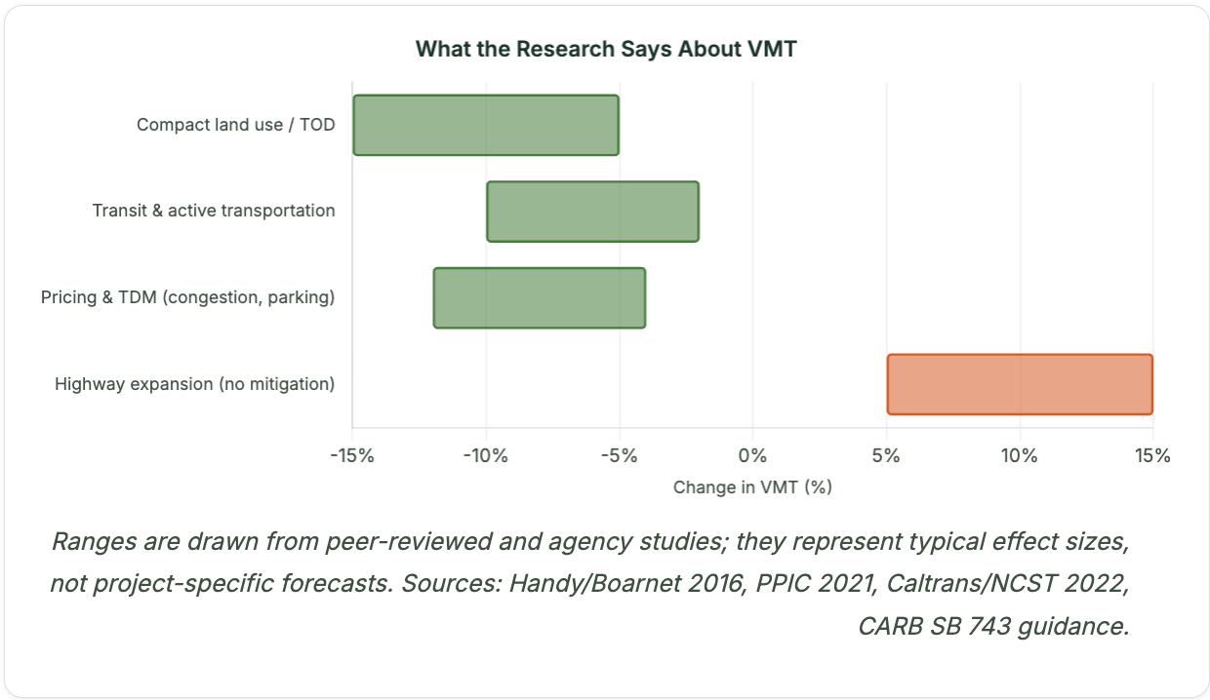
Data Dashboard: Policy Scenarios Visualized
A live translation layer between raw California tract-level data and actionable policy argument: built for advocates, planners, and decision-makers.
Leaflet Map
Chart Visualizations
Policy Scenarios
8,000+ tracts colored by VMT index with DAC overlay, hotspot highlighting, and toggleable intensity view
VMT-reduction scenarios by policy approach, GHG trajectory projections, and equity bar charts with literature-informed ranges
Policy transfer calculator, climate-floor scoring, corridor diagnostics, and downloadable executive briefs

Slide 14
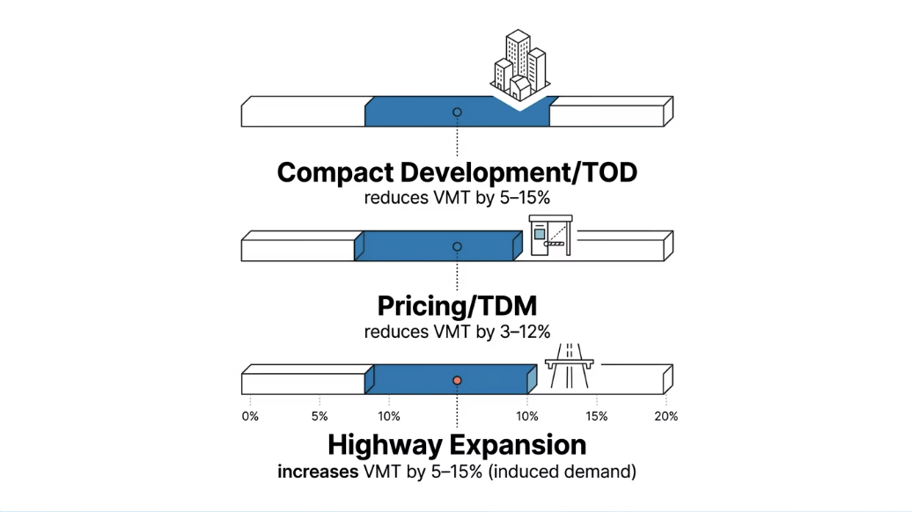
Data Stories: Hotspot Corridors Face Highest Burdens
309
23.4
3.35
Hotspot Tracts
DAC mile/day VMT
tCO₂ per tract
High-VMT and high-pollution concentrated along I-710, I-105, SR-99, and I-80
vs. 22.5 for non-DAC tracts:
modest mean difference masking extreme corridor-level burdens
Estimated annual GHG burden at hotspot corridors

Slide 15
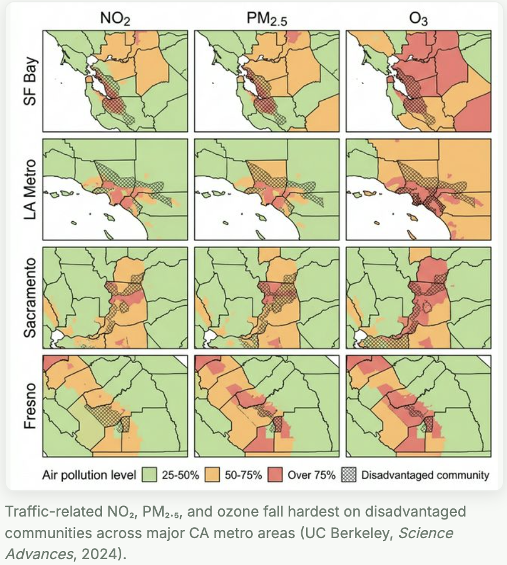
Health & Equity Impacts in Overburdened Communities
The communities closest to California's busiest freeways face some of the worst air quality, the highest emissions exposure, and the fewest transportation alternatives.
Current Issues
Reformed Investment Potential
1. Communities by highway corridors experience elevated health effects.
1. Redirecting funds toward transit, walking, & infill housing delivers some of greatest health gains in overburdened communities.
2. Low-income + minority communities carry disproportionate share of traffic-related air pollution.
2. Corrective action requirements: recurring opportunities to direct investments toward overburdened communities.
3. Highway expansions move forward unchecked, alternative investments (transit access, safe sidewalks, clean air corridors) remain underfunded.
3. Multimodal access scoring encourages investments in transit, walking, and biking that expand options for low-income households.
11
Notes:
I want to be transparent about a methodological choice here. We used per-capita VMT as our primary metric, which can actually undercount burden in places like the Central Valley, where absolute freight traffic is enormous but spread across a smaller population. The 309 hotspot number is conservative. The human reality — elevated asthma rates, cardiovascular disease, premature death near these corridors — is well-documented in the literature and should not be obscured by the averages. Note: per-capita VMT can appear lower in dense urban corridors even when absolute pollution burden is highest.
• 309 hotspots census tracts: high VMT and high pollution burden
• I-710, I-105, SR-99, and I-80 corridors
• Central Valley: lower per-capita VMT but concentrated freight and agricultural traffic exposure
• Reformed investment: transit, walking infrastructure, infill housing

Slide 16

Recommendations & Ask
NRDC
Transportation Planners
Deploy the three-scenario framework and dashboard in legislative advocacy.
Dashboard & data pipeline open-source and reproducible. Any MPO, NGO, or researcher can fork, adapt, and deploy.
California
Bay Area City Planners
Input VMT-accountability statutory and regulatory language.
Prioritize multimodal investments and strengthen protections and engagement in underserved communities.

Slide 17








Acknowledgements and Special Thanks
Zak Accuardi
Director, Mobility Choices, Climate & Energy at NRDC
Liane Randolph, JD
Former Chair, California Air Resources Board and California Public Utilities Commission
Ergon Terplan
Senior Policy Advisor, UC Berkeley Institute of Transportation Studies; Former Senior Advisor for Economic Development and Transportation at Governor’s Office of Planning and Research
Cole Roberts
Americas Energy Business Climate & Sustainability Services Partner at ARUP
Kara Vuicich
Bay Area Metropolitan Transportation Commission Principal Planner, Regional Planning Program
Karen Frick, PhD
Director, Institute of Urban & Regional Development at UC Berkeley; Associate Professor of City & Regional Planning
Sooji Yang
Master of Public Policy ‘26, UCLA Luskin School of Public Affairs
Saikat Chakrabarti
Former Chief of Staff for Rep. Alexandria Ocasio-Cortez
Scott Wiener
California State Senator, 11th District

Slide 18


Thank you!

